Slide 1

TECHNOLOGY
ROBOTICS

Slide 2

What comes in your Mind ?

Slide 3


Slide 4
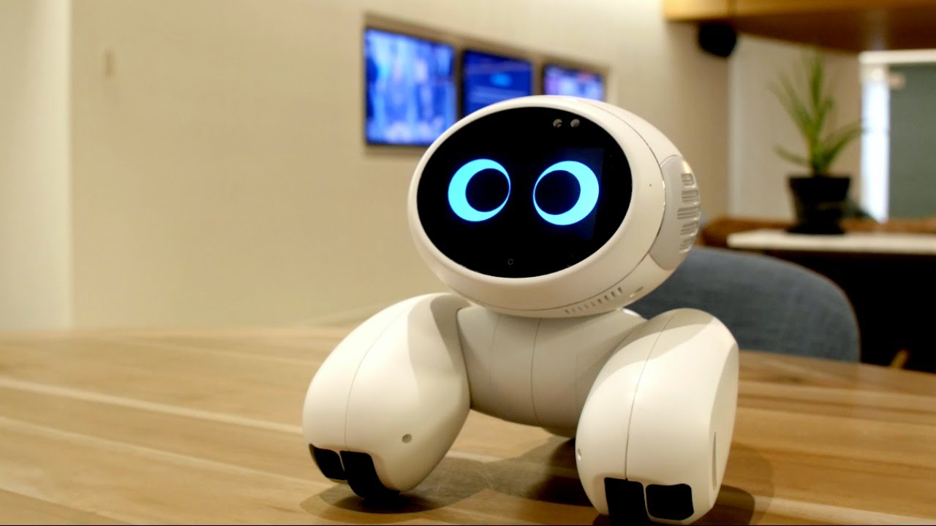

Slide 5
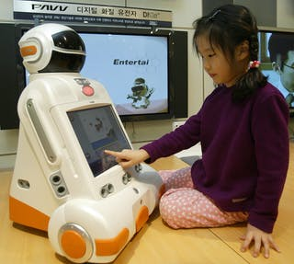

Slide 6
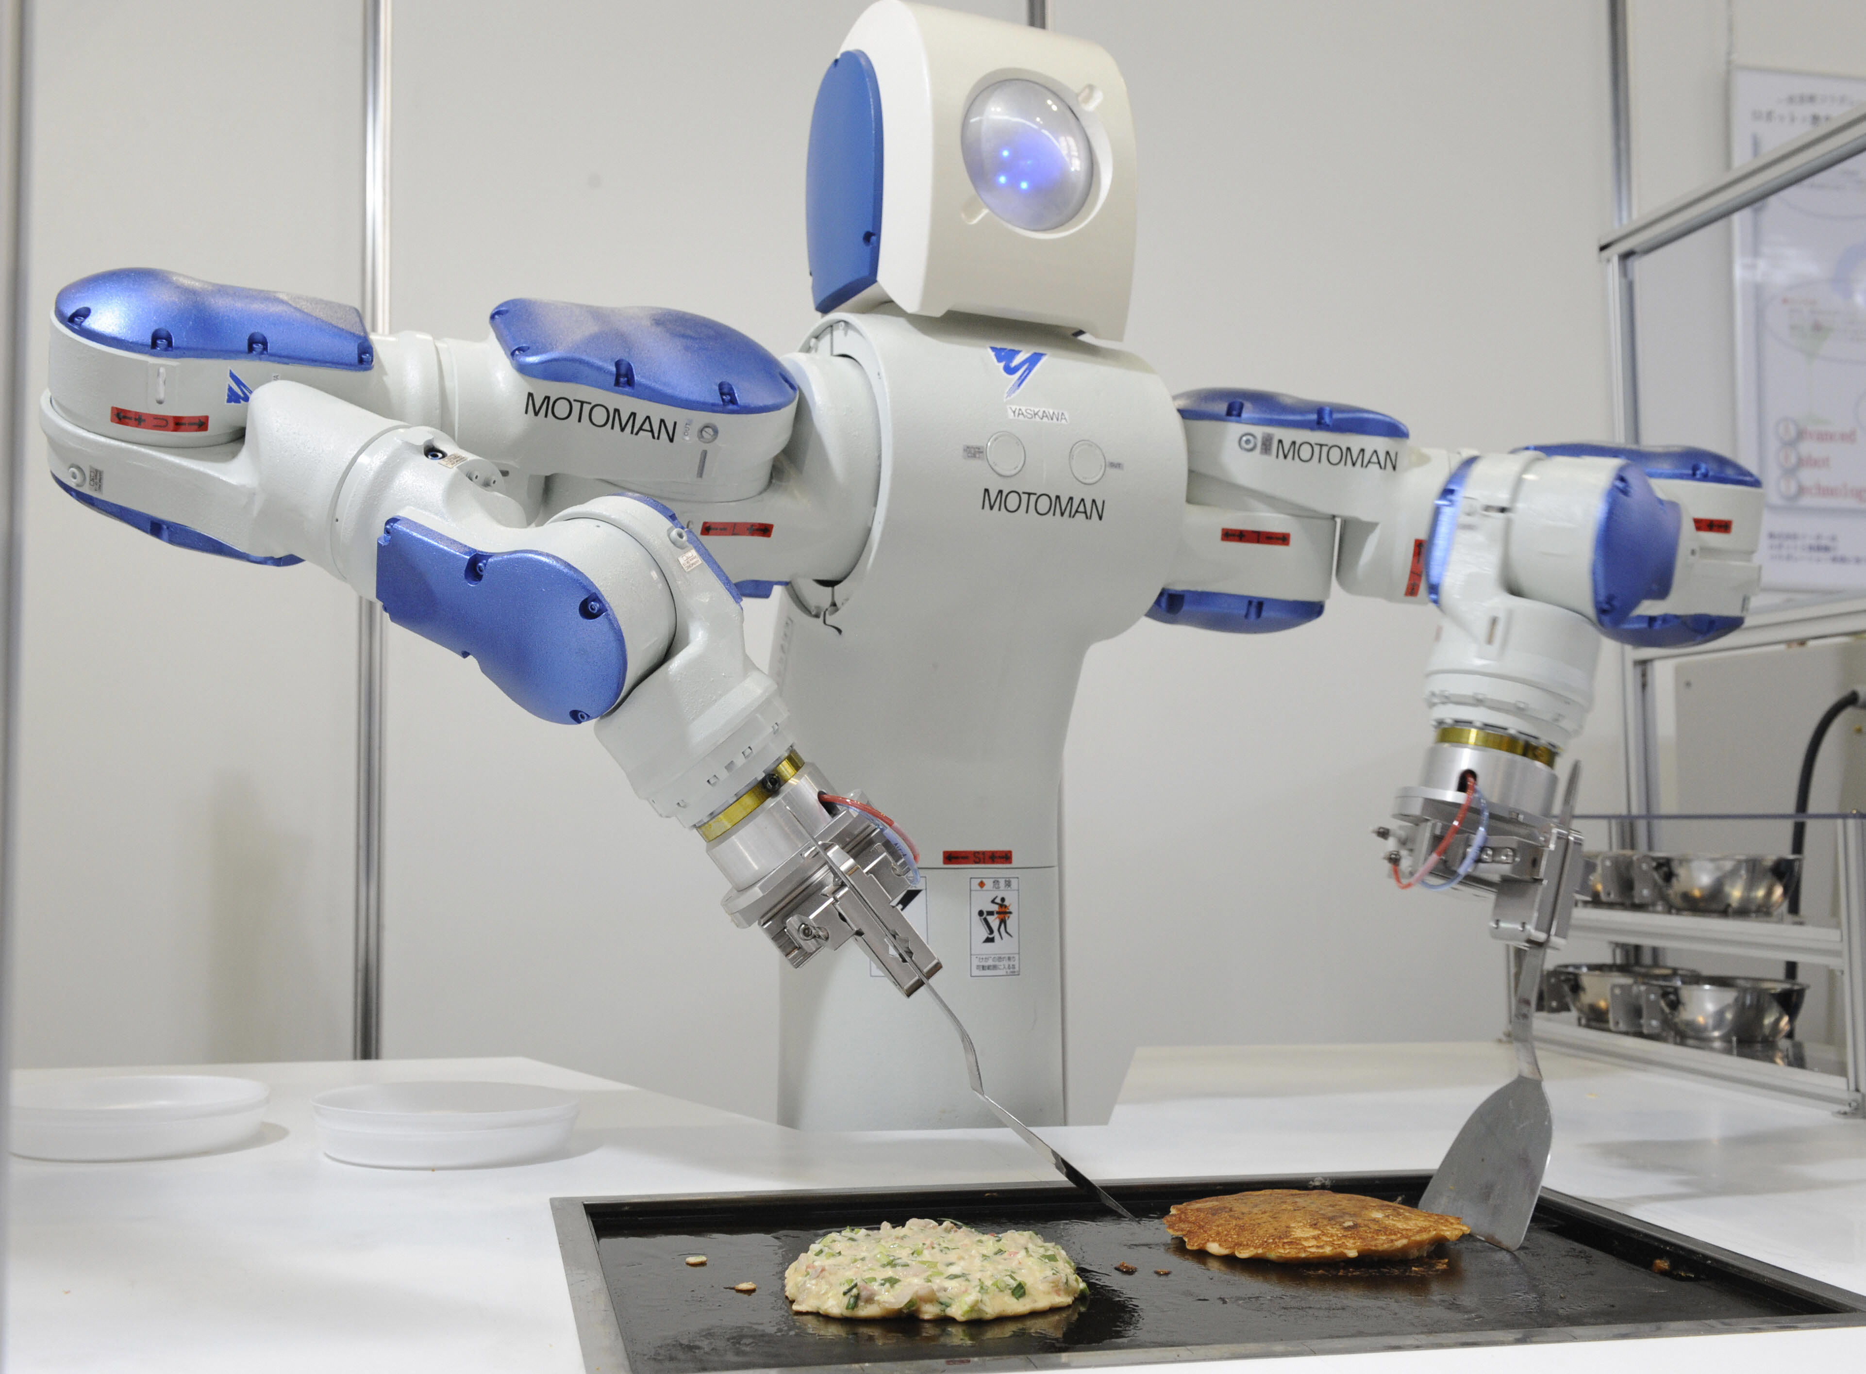

Slide 7
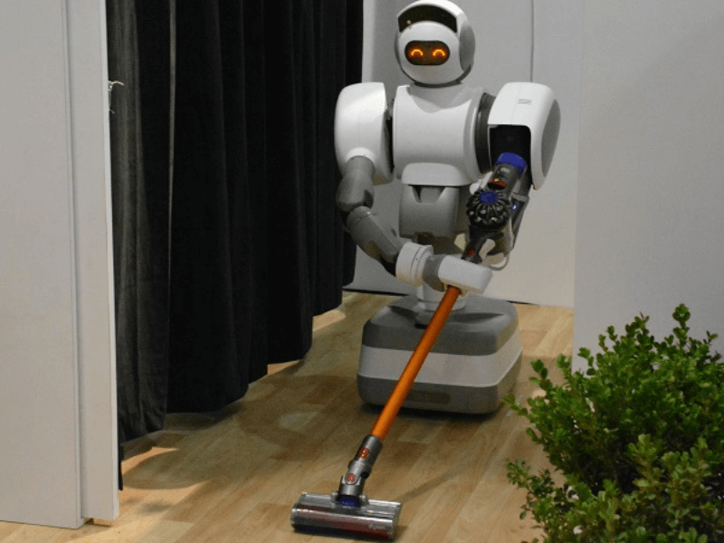

Slide 8
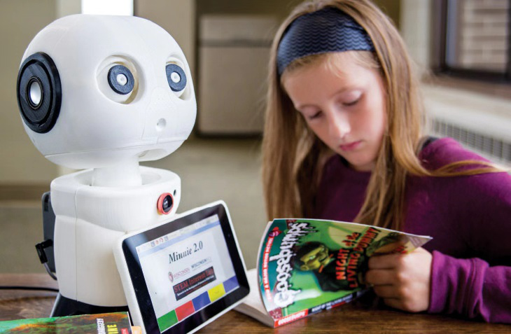

Slide 9
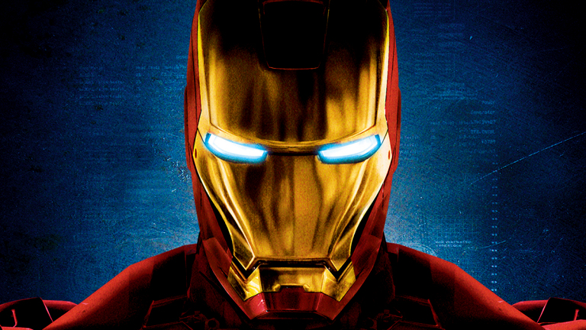

Slide 10
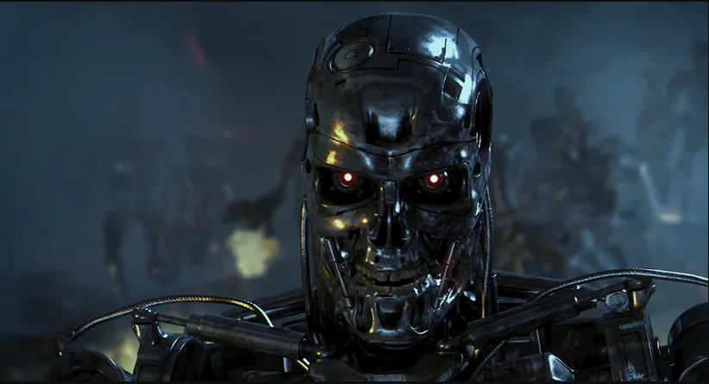

Slide 11
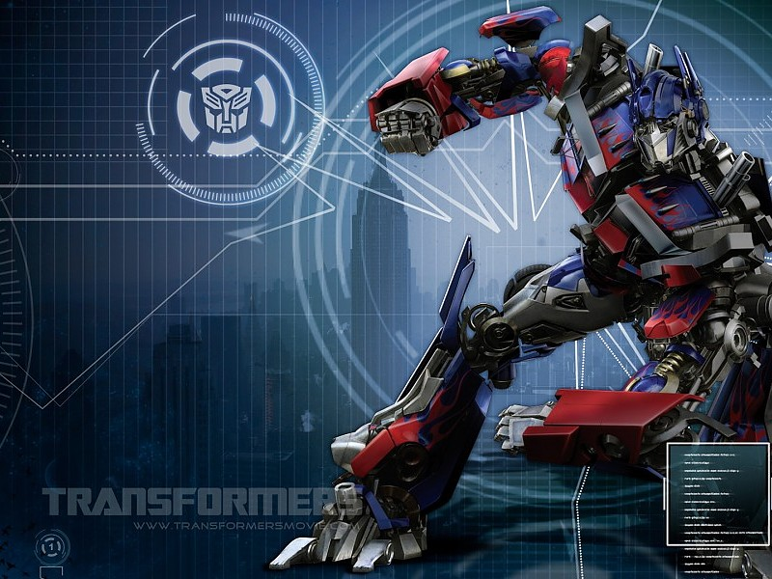

Slide 12
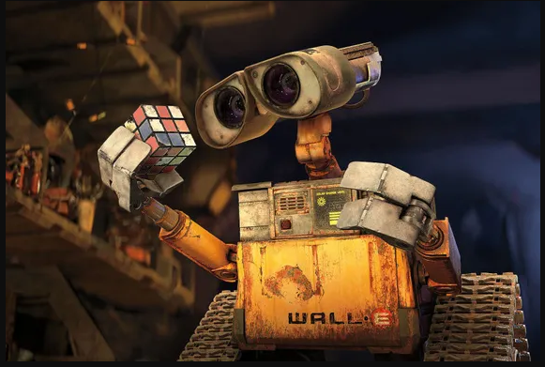

Slide 13
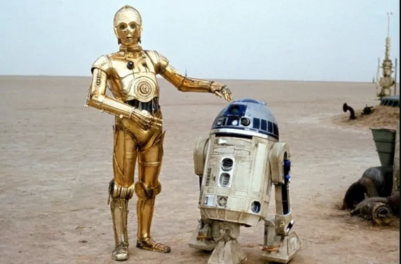

Slide 14
History of Robot word ?
Robot is drawn from an old Church Slavonic word, robota, for “servitude,” “forced labor” or “slave.”

Slide 15
Which country made the first robot?
Japan
In 1967 the first industrial robot

Slide 16
Who is the father of robotics?
Joseph Engelberger
Columbia University (B.S., 1946; M.S., 1949)

Slide 17
Who invented the first robot in 1921?
Karel Capek

Slide 18
Robotics terminology
Robot - Mechanical device that performs human tasks, either automatically or by remote control.
Robotics - Study and application of robot technology.

Slide 19
Robot Definition
What is the Definition of a Robot?
A programmable or non programmable multifunctional manipulator designed to move material, parts, tools or specialized devices through various motions for the performance of a variety of Tasks.
Robot Institute of America.

Slide 20
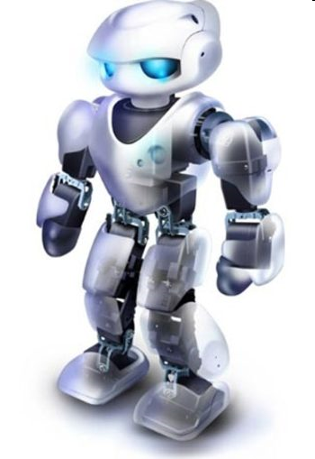
Laws of Robotics
Isaac Asimov popularized the term robotics. Asimov is a visionary who envisioned in the 1930’s the positronic brain for controlling robots. He invented the three laws of robotics:
A robot may not harm a human through action or inaction, allow a human to come to harm
A robot must obey the orders given by human beings, except when such orders conflict with the First Law
A robot must protect its own existence as long as it does not conflict with the First or Second Laws

Slide 21
First Social Robot

Slide 22
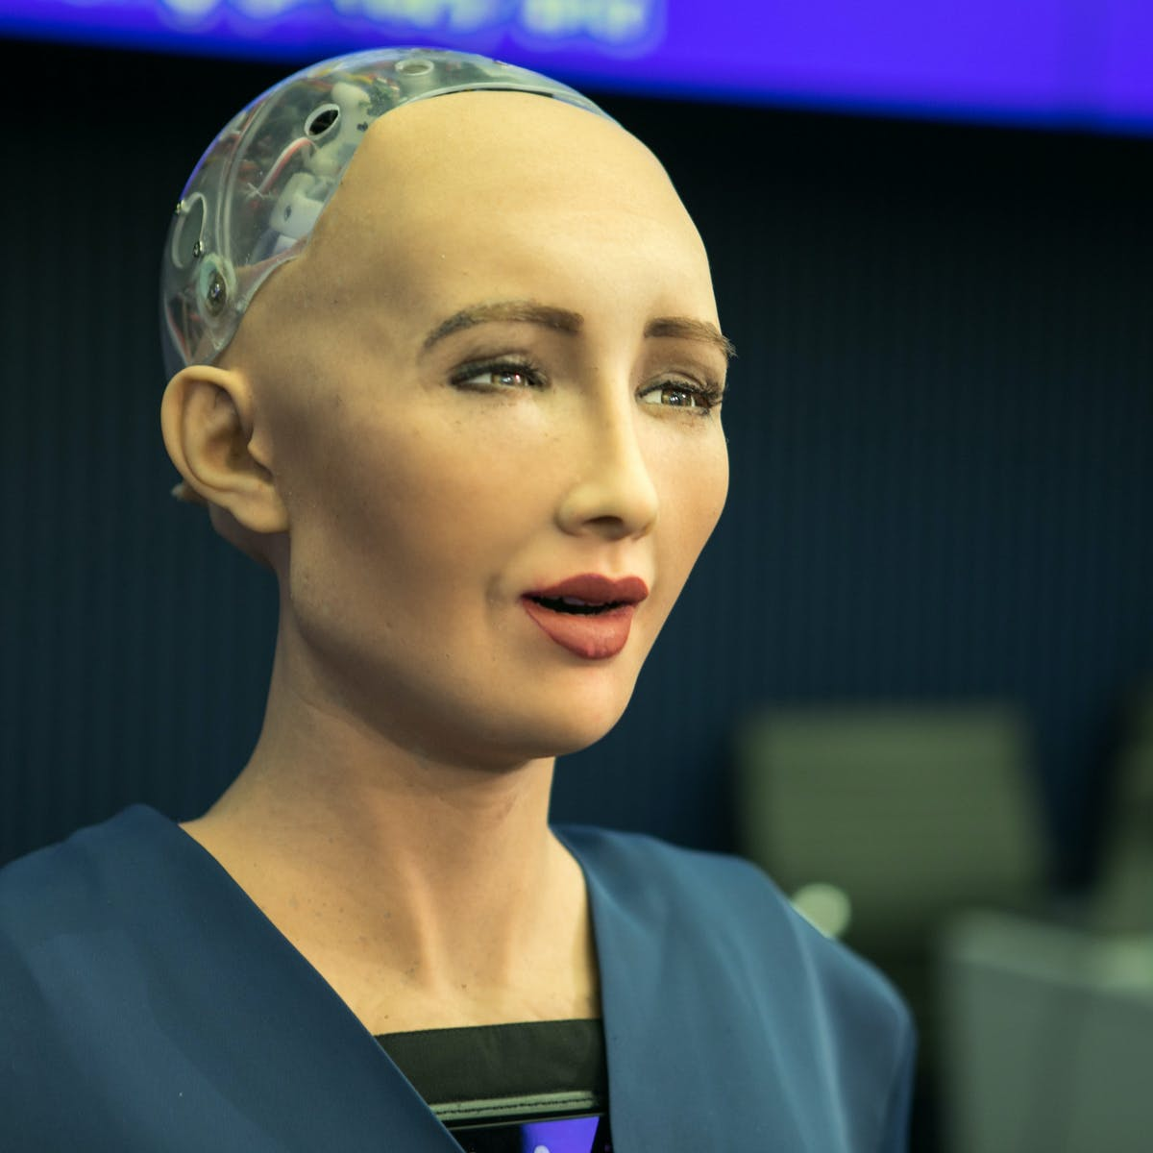

Slide 23
Features
Appearance. Human-sized appearance. Most realistic human-like expressive face. ...
Expression. Integrated set of human-like emotional expressions. Sentence and context understanding with cloud connection. ...
Motion. 74 degrees of freedom. ...
Sensors. Face detection and body tracking.

Slide 24
Will robots replace humans in future ?

Slide 25


Slide 26
Robotics Applications

Slide 27
Use of robots
Robots are also used for the following tasks:
Dirty Tasks
Repetitive tasks
Dangerous tasks
Impossible tasks
Robots assisting the handicapped
Can operate equipment's at much higher precision than humans.

Slide 28
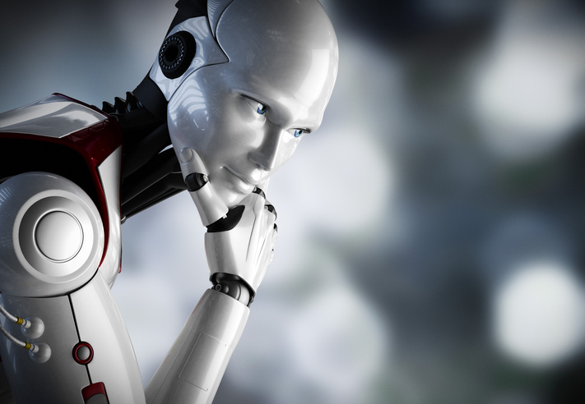

Slide 29


Slide 30
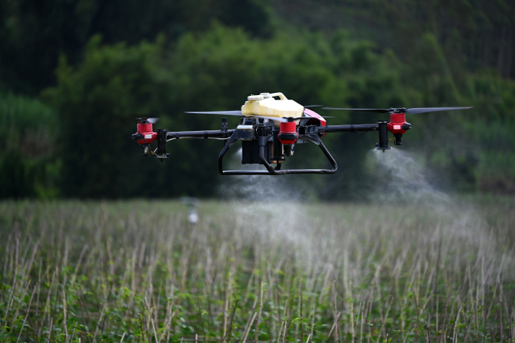

Slide 31
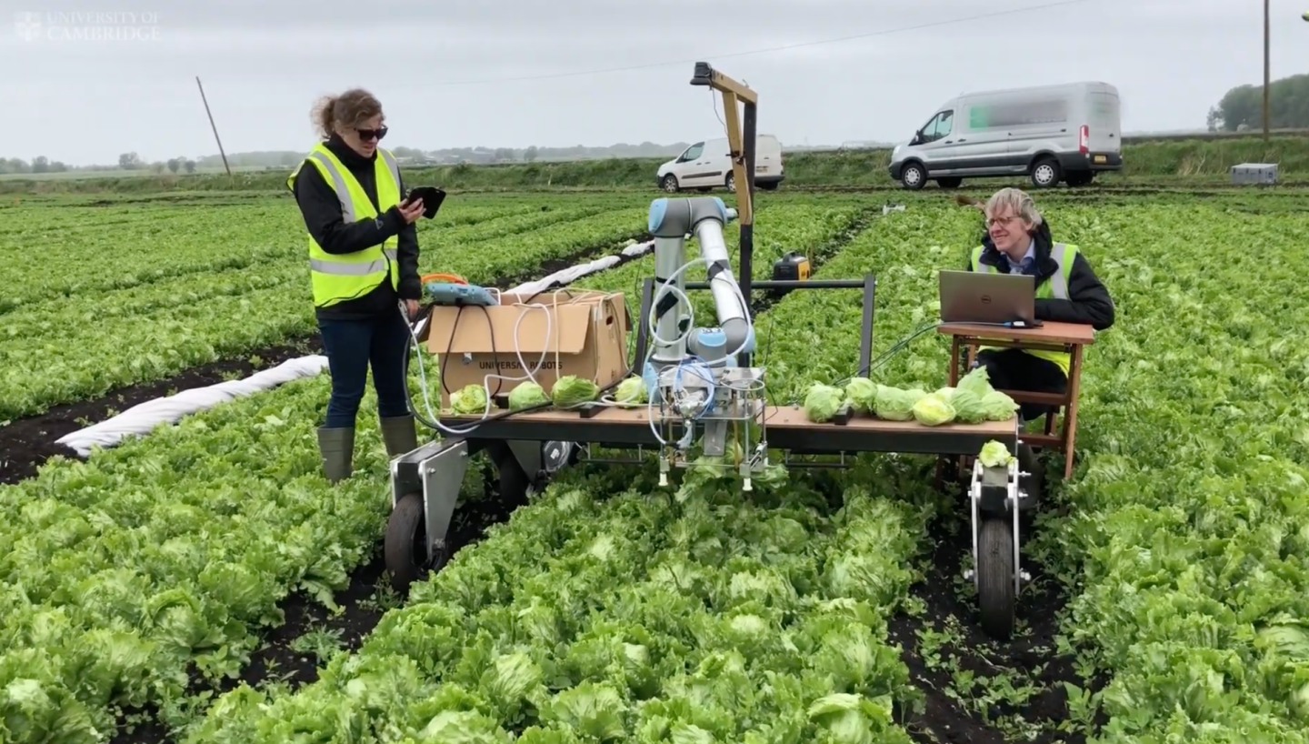

Slide 32
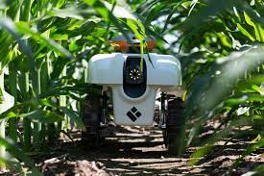

Slide 33

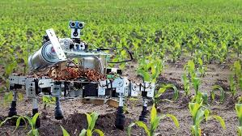
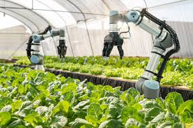

Slide 34


Slide 35


Slide 36
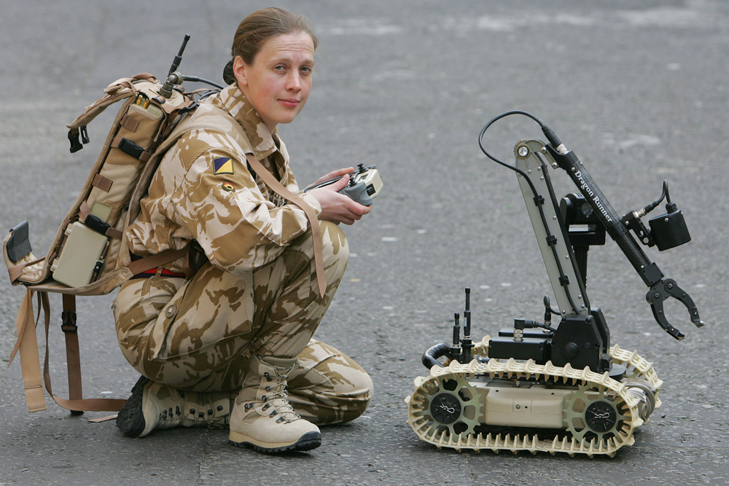

Slide 37
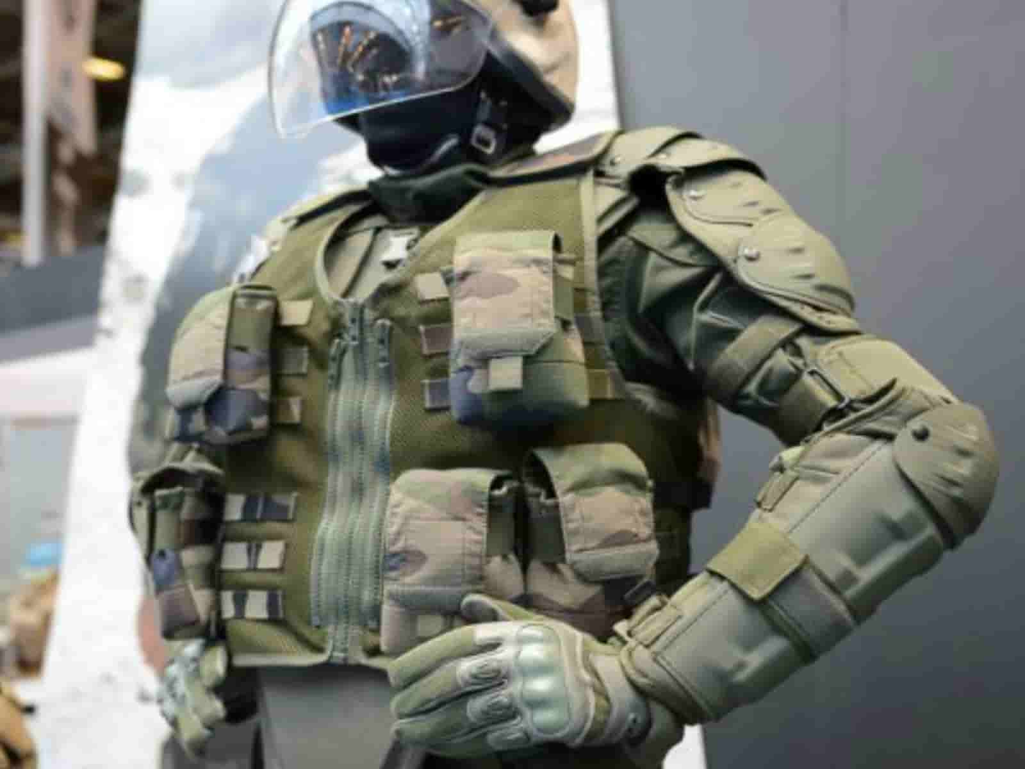

Slide 38


Slide 39
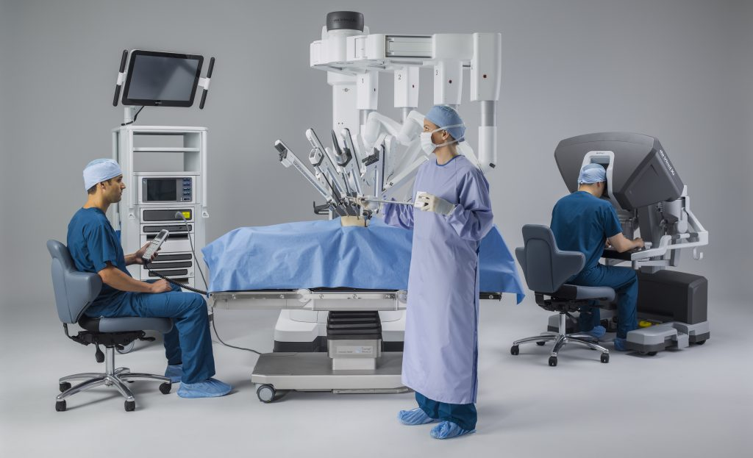

Slide 40
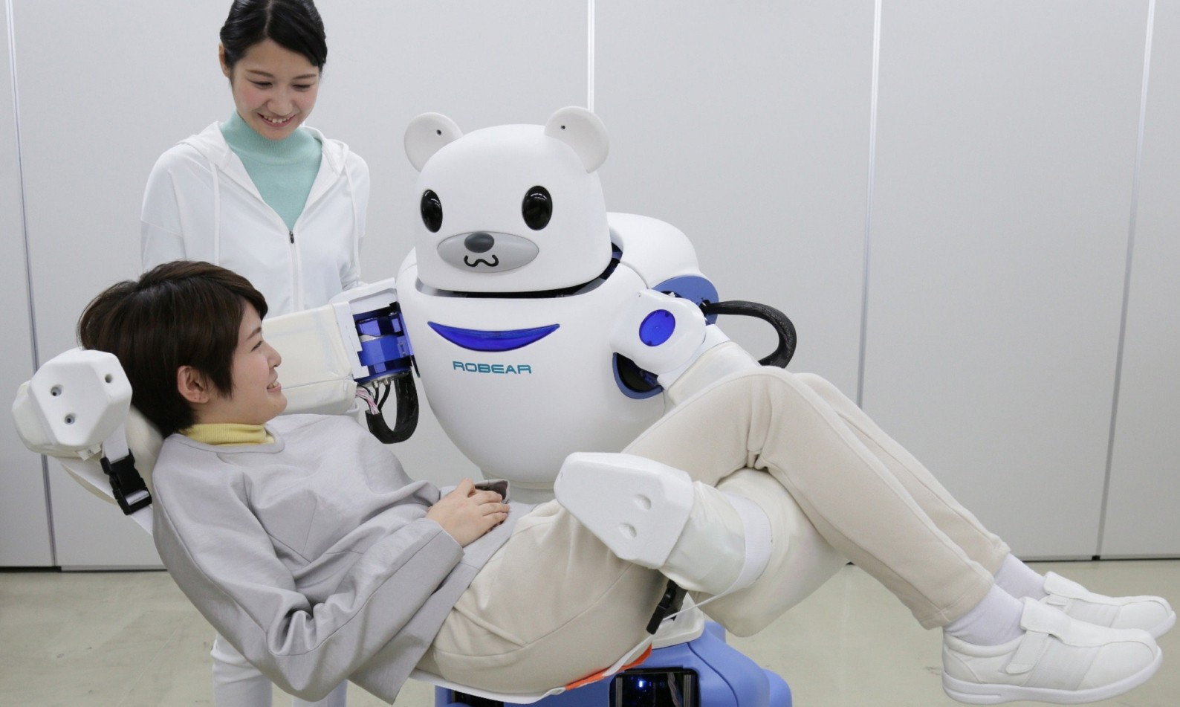

Slide 41
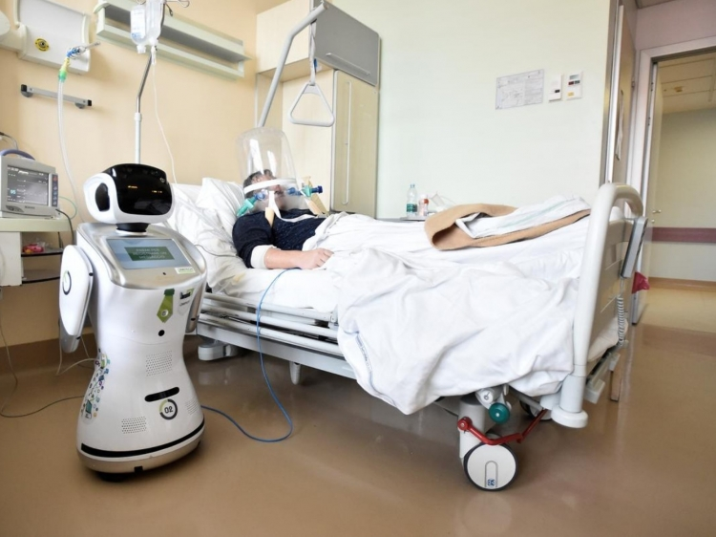

Slide 42
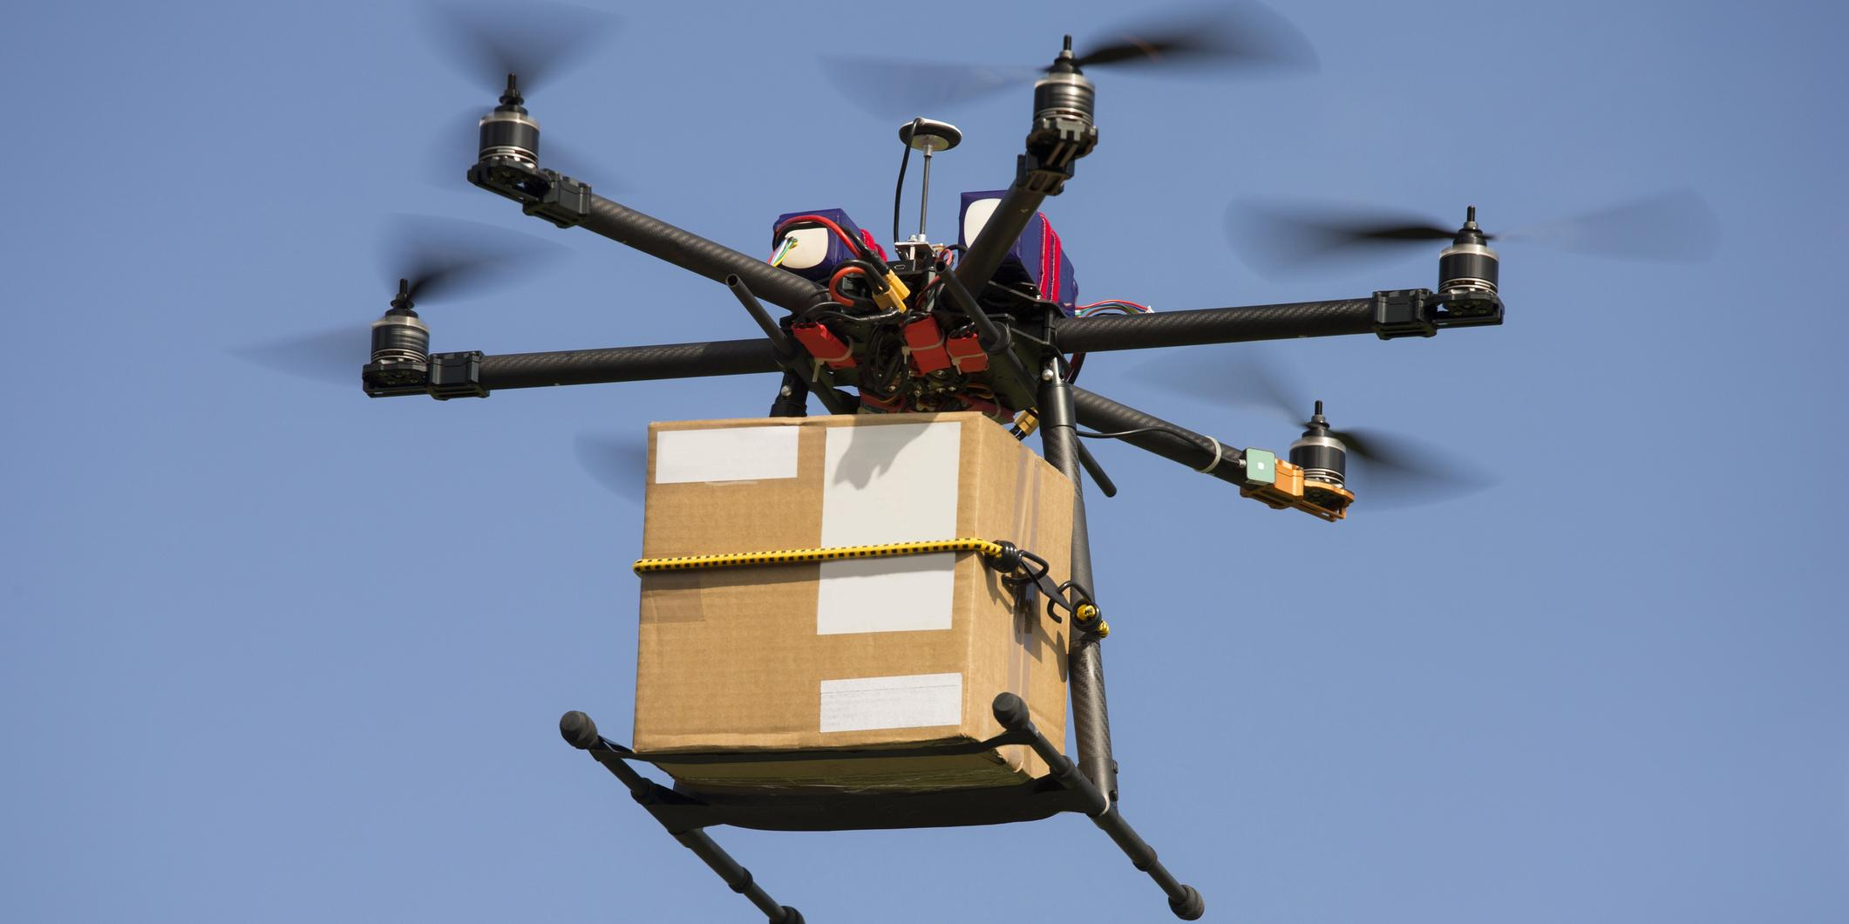

Slide 43


Slide 44
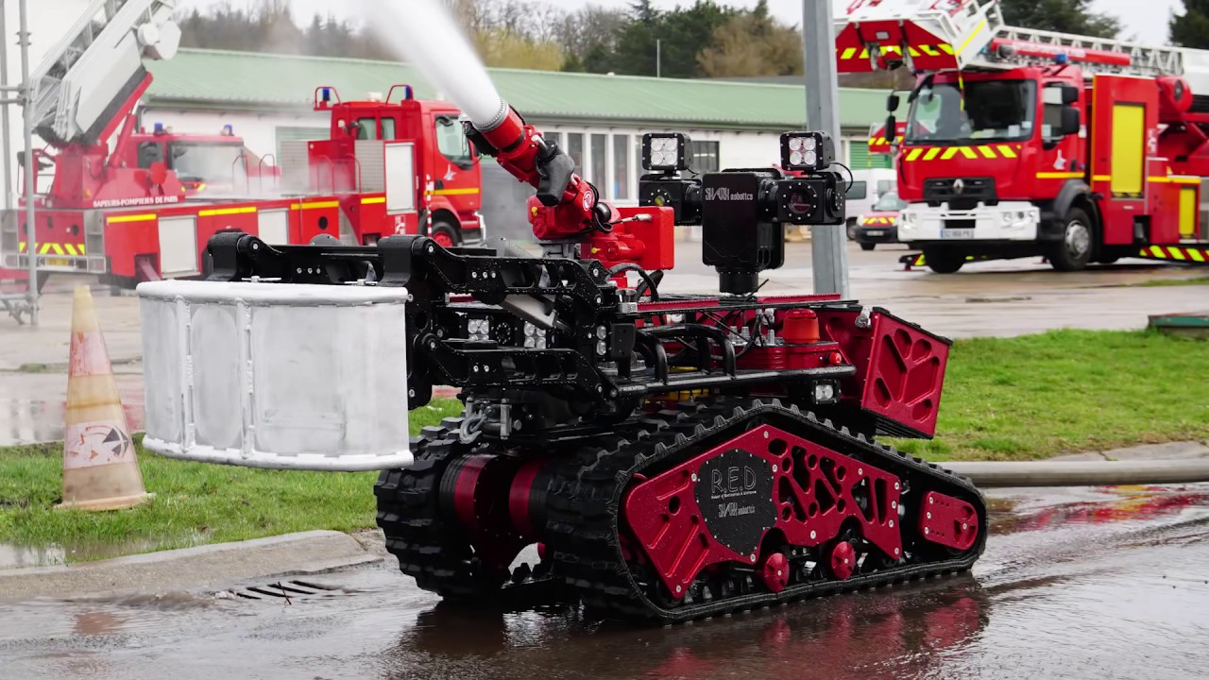

Slide 45
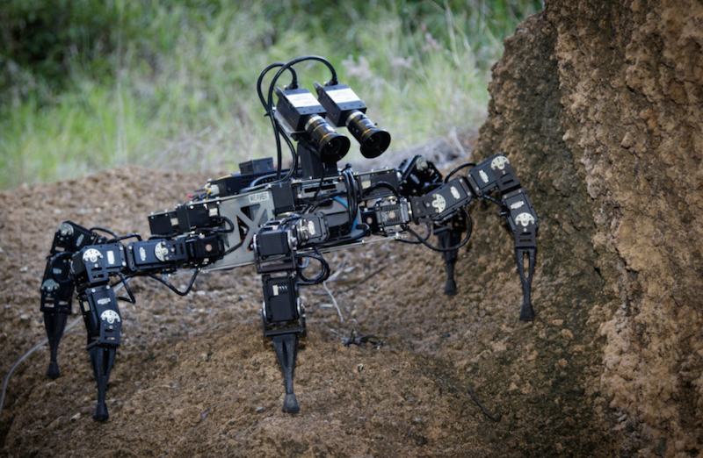

Slide 46


Slide 47
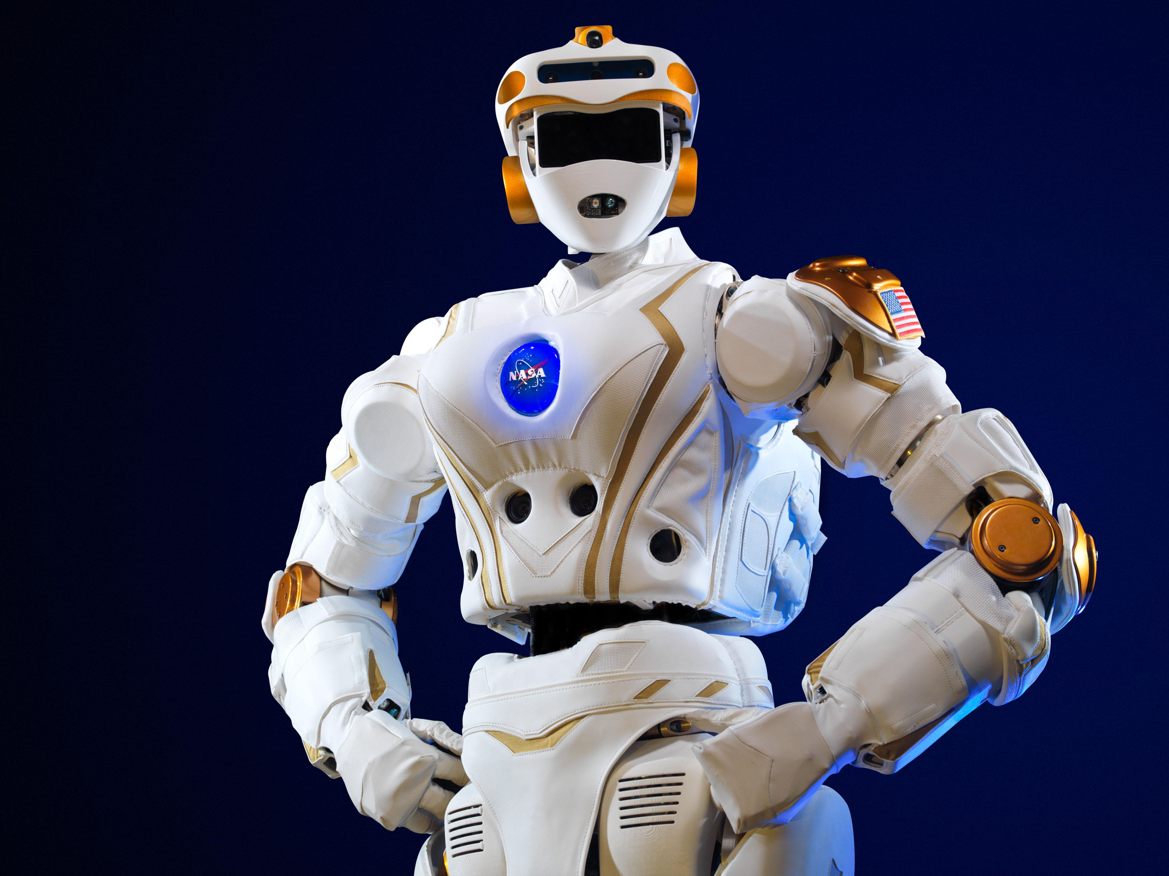

Slide 48
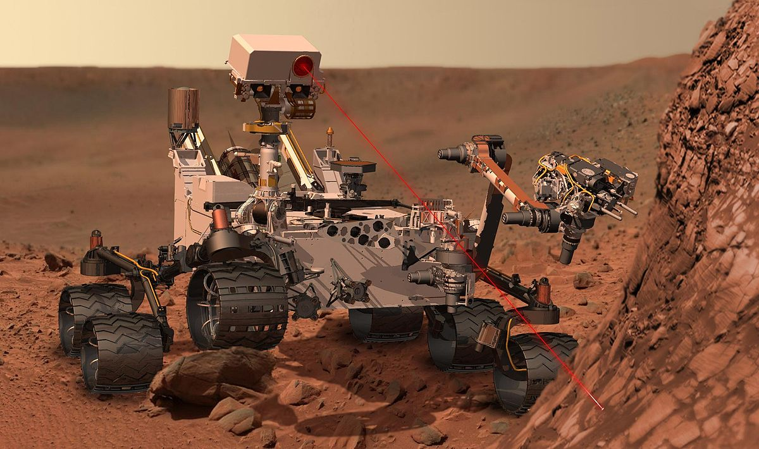

Slide 49
Conclusion
Although most robots in use today are designed for specific tasks, the goal is to make universal robots, robots flexible enough to do just about anything a human can do.

Slide 50

Thank you !

Slide 51
MOTORS

Slide 52
Types of motors
AC motors
DC motors
DC geared motors
Stepper motors
Servo motors

Slide 53
AC Motor
These are the motors which convert alternating signal into rotational motion.
Examples are the motor in water pumps, table fan, ceiling fan.

Slide 54
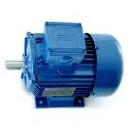

Slide 55
DC Motor
These are the motors which convert DC signals into rotational motion.
In robotics applications they are preferred over AC motors as the motor and the complete circuit require same kind of supply i.e DC supply.

Slide 56
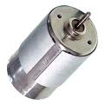

Slide 57
DC geared motors
These are the DC geared motors having external gear arrangement attached with motor.
These are the motors that are most commonly used in robotics as they are having considerable torque.

Slide 58
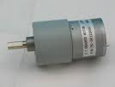
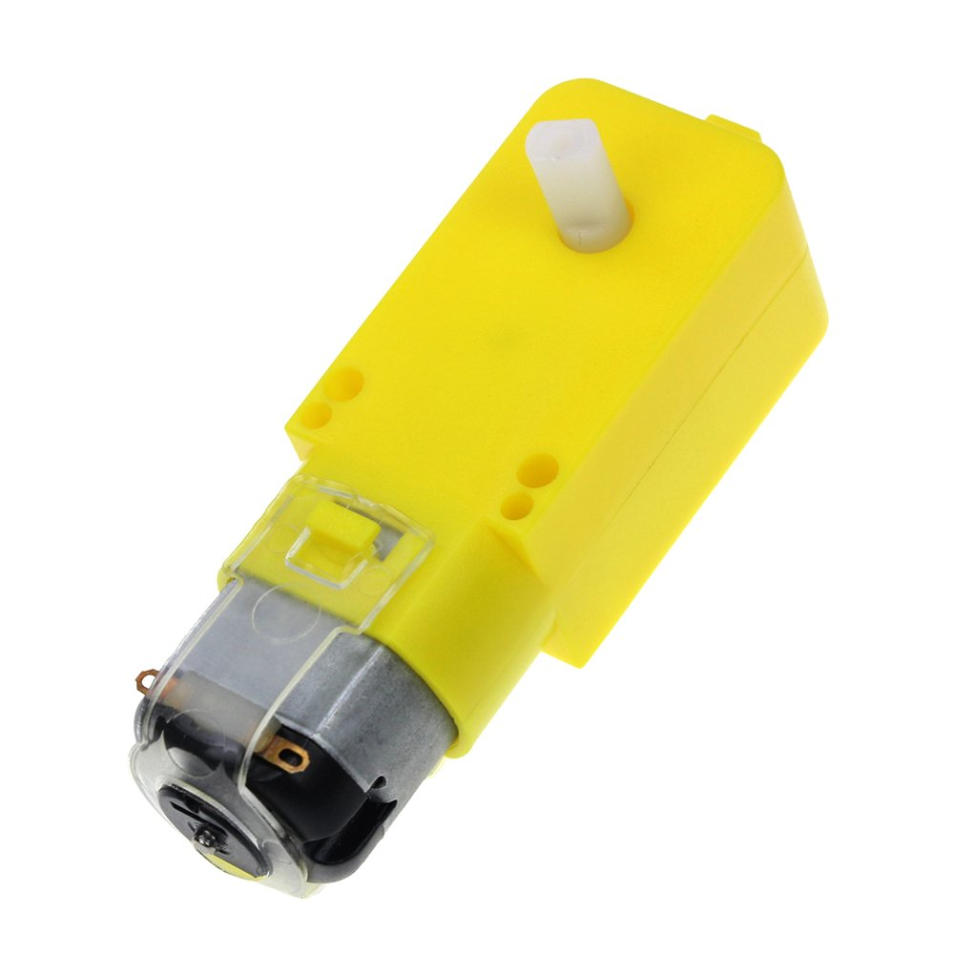
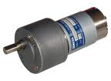

Slide 59
Stepper Motor
A type of motor which takes DC pulse input and gives rotating motion in steps.
They are of two types :
Unipolar : which moves in one direction
only.
Bipolar : which moves in both directions.

Slide 60
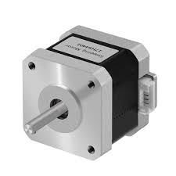

Slide 61
SERVO MOTOR

Slide 62
Servo motors are the most powerful motors for robotic applications.
They comes in both varients , AC and DC.
They can change the direction with same supply .

Slide 63
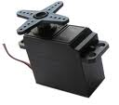

Slide 64
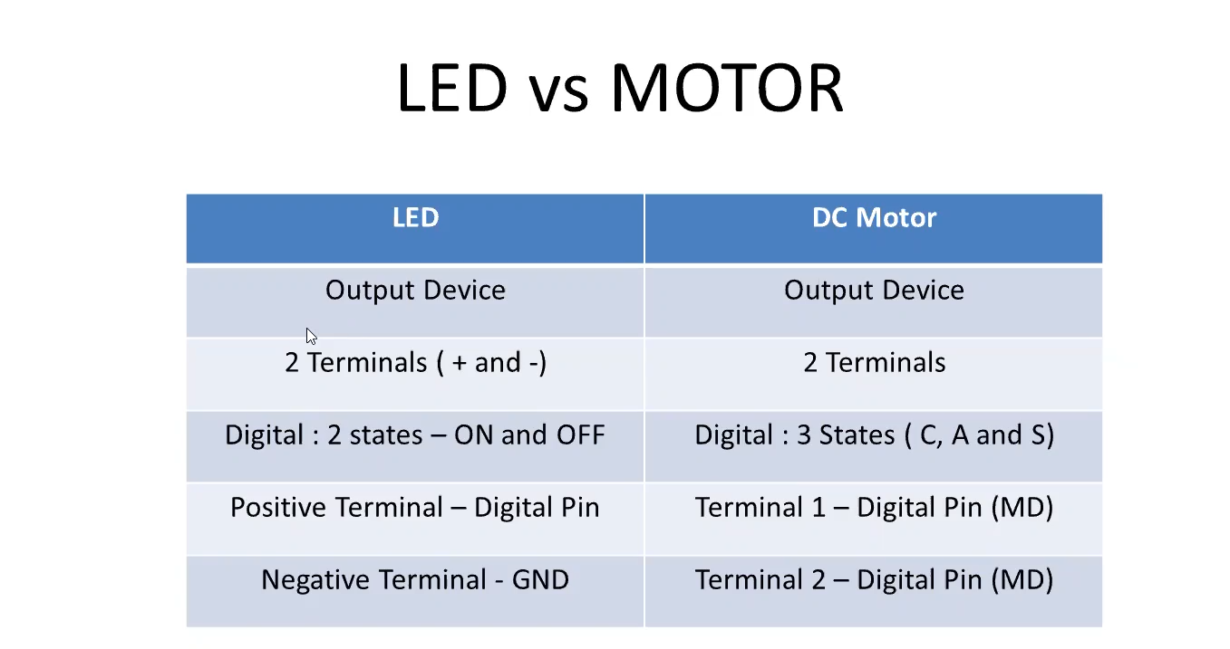

Slide 65
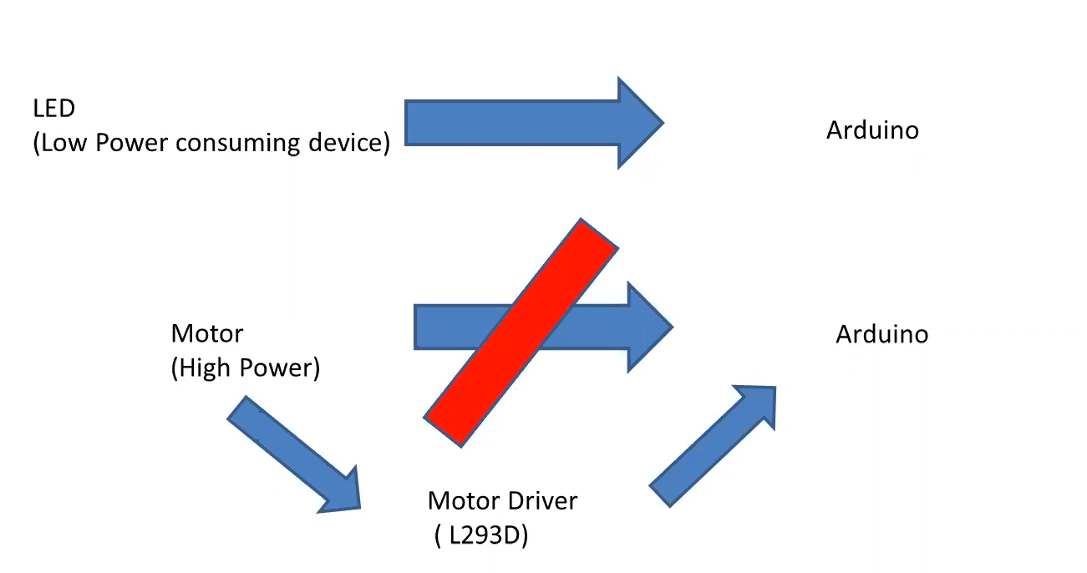

Slide 66
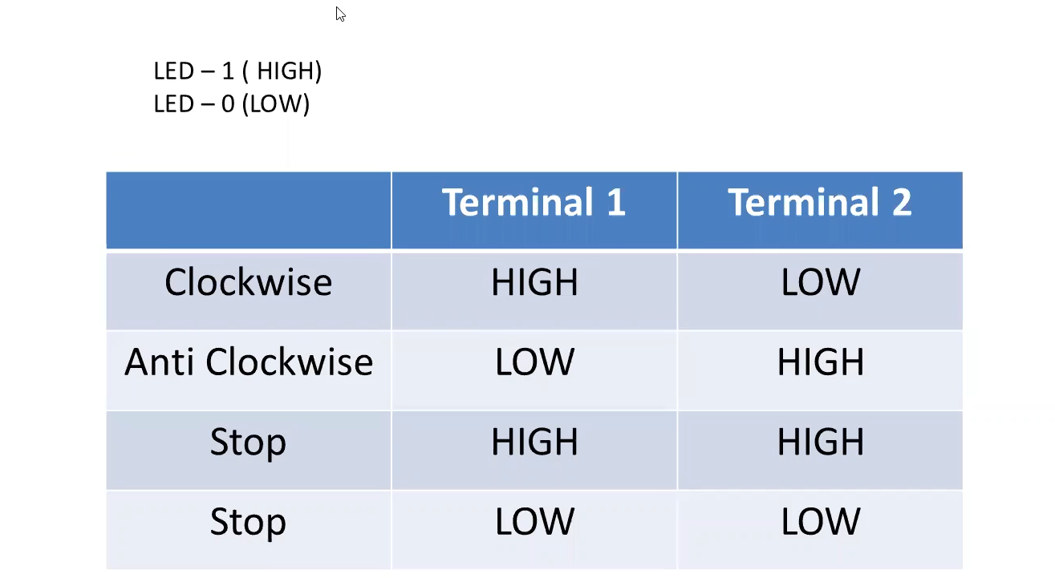

Slide 67
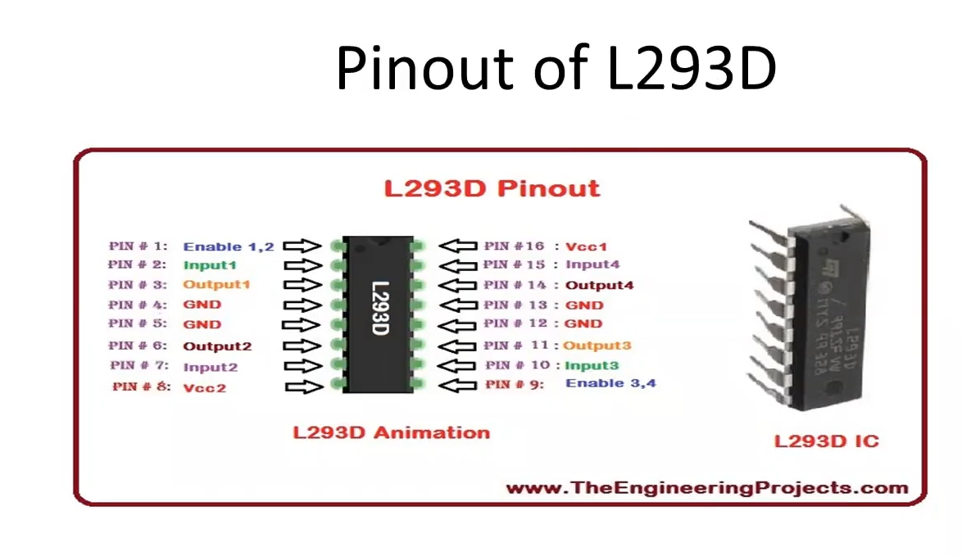
DC Motor

Slide 68
Remote Controlled Car (Based on two motors)
Controlling the car from Serial Monitor--Tinkercad
Controlling the car from mobile app—Bluetooth (Optional)

Slide 69
2 motors—backside of the chassis 1) Forward (clockwise)
2) Backward (anticlockwise)
3) Right
4) Left
5) Stop
1 castor ball (Balancing wheel)

Slide 70
ROBOT’S MOVEMENT (Anti- Forward, Clock-Backward)
LEFT MOTOR RIGHT MOTOR
FORWARD F F
BACKWARD B B
LEFT S F
RIGHT F S
STOP S S

Slide 71
LEFT MOTOR RIGHT MOTOR
LEFT STOP FORWARD
LEFT BACKWARD FORWARD
LEFT FORWARD (SLOW) FORWARD(FAST)

Slide 72
Create a robotic car to be controlled by serial monitor commands
Commands taken should be in the form of String
It should contain 2 motors
Consider Clockwise as forward and anticlockwise as backward
Commands
--FORWARD
--BACKWARD
--RIGHT
--LEFT
--STOP

Slide 73
COMPONENTS :
Arduino Uno
Arduino Uno USB Cable
L293D Motor Driver board
DC Motors -2
Castor Wheel
Chassis
Wheel
Jumper Cables
BlueTooth HC05 (4 pins, STATE and KEY not included)
Powerbank

